Slide 1



NEURO-SCAN
PROJECT
Presented by:
Dhruv Sharma 20120803120, IT
Monish Tyagi 08020803120, IT
Rajat Sharma 09320803120, IT
Ankit Gupta 01520803120, IT

Slide 2

Overview
INTRODUCTION
PROBLEM STATEMENT
DESIGN PHASE
WORK DONE
REFERENCES

Slide 3


INTRODUCTION
In this groundbreaking project, we have endeavored to develop an innovative and robust brain tumor detection system, seamlessly integrating a trifecta of cutting-edge technologies. At its core, this endeavor leverages the power of Convolutional Neural Networks (CNNs), a class of deep learning algorithms revered for their exceptional proficiency in image recognition tasks, particularly in the realm of medical imaging. With this formidable neural network architecture in place, our system adeptly analyzes intricate brain scans with unparalleled precision and accuracy. Complementing this formidable deep learning backbone is a meticulously crafted web application, forged with the dynamic capabilities of ReactJs for the front-end, ensuring an intuitive and engaging user experience, while Tailwind CSS lends its finesse to the aesthetic elements, harmoniously combining functionality with visual appeal. On the server side, ExpressJS, a fast and minimalistic web application framework, deftly orchestrates the flow of information, efficiently processing user requests and interfacing seamlessly with the deep learning model. Together, this amalgamation of technologies represents a quantum leap in the field of medical imaging analysis, exemplifying an interdisciplinary approach that promises to revolutionize the way brain tumors are detected and diagnosed.

Slide 4




PROBLEM STATEMENT
Brain tumors pose a significant medical challenge, requiring accurate and timely diagnosis for effective treatment planning and improved patient outcomes. Current diagnostic practices often rely on manual inspection of medical imaging, which can be time-consuming, subjective, and prone to human error. To address this critical issue, this project aims to develop a sophisticated brain tumor detection system utilizing a combination of modern technologies.
.
FEATURES
The system will be engineered to process uploaded images in real-time, providing immediate feedback to users. This ensures prompt evaluation and subsequent actions based on the results.
The application will offer a detailed visualization of detected tumors, along with relevant metrics such as size, location, and potential classifications. This information will empower users with valuable insights for further medical assessment.
VULNERABILITIES
Ensuring the CNN model is well-trained on diverse datasets is critical to achieving high accuracy. Continuous model evaluation, fine-tuning, and augmentation techniques will be employed to enhance performance.

Slide 5
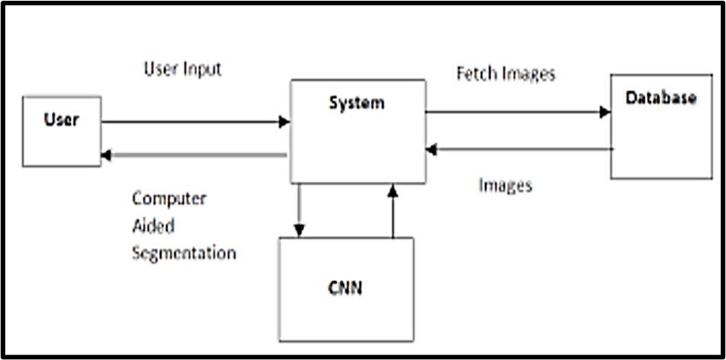
DESIGN PHASE
DATA FLOW DIAGRAM

Slide 6

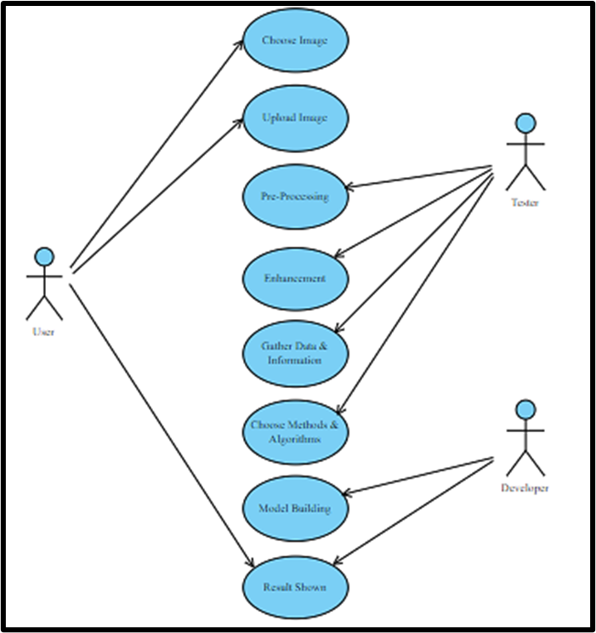

USE CASE DIAGRAM

Slide 7


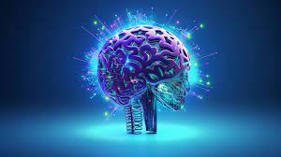


MODEL TRAINING
DATA COLLECTION
Gathering a comprehensive dataset containing information about a large number of individuals
FEATURE COLLECTION
identifying the most relevant input variables (features) from the dataset that are statistically associated with the risk of heart disease
DATA PRE-PROCESSING
Cleaning and preparing the data by handling missing values, normalizing numerical features, and encoding categorical variables
MODELTRAINING
ASSESSING THE PERFORMANCE OF THE TRAINED MODEL USING VARIOUS METRICS LIKE ACCURACY, PRECISION, RECALL, F1-SCORE, AND AREA UNDER

Slide 8
THANK YOU
For watching this presentation

